Slide 1
EXCEL REASSESSMENT
PREETHI R
4297

Slide 2
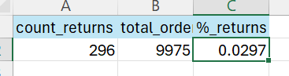
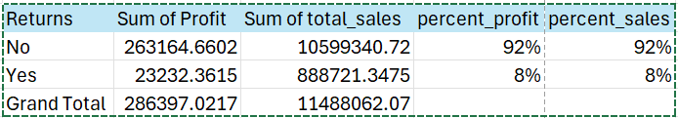
FORMULA:
=COUNTA(Returns!A2:A297)
=COUNTA(Orders!B20:B9994)
=A2/B2
Q1.
INSIGHTS:
Calculated the percent of returns using count formula
Using pivot table, the impact of returns can be seen
INFERENCE:
From table, we can see than due to product returns, 8% of profit and total sales is loss

Slide 3
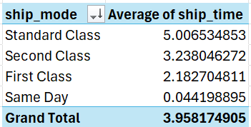
FORMULA:
Q2.
INSIGHTS:
Created new column ship_time in main data
Using pivot table, calculated average ship time
INFERENCE:
Same Day has fastest average ship time
Standard class has high average ship time which means it is the slowest delivery

Slide 4
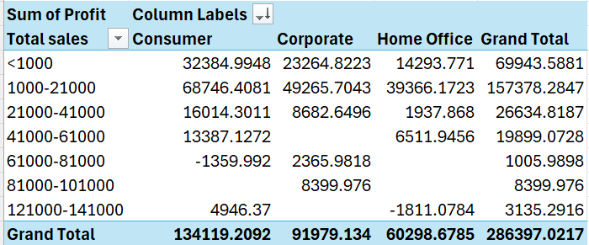
FORMULA:
Q3.
INSIGHTS:
Using pivot table, segmentation is performed
Using grouping option, customers are grouped respect to total sales
It is also divided using sum of profits
INFERENCE:
Overall profit is high for consumer segment whereas low for home office segment
If we concentrate more on consumer segments, we can earn more profits
Mostly, the profits are earned in total sales below rs.61000

Slide 5
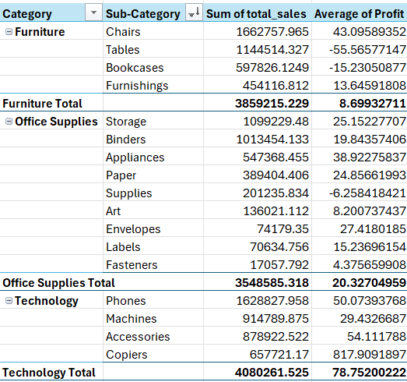
FORMULA:
Q4.
INSIGHTS:
Using pivot table, data is loaded
By selecting show in tabular form, the data is viewed in tabular form
Product performance can be viewed with the help of total sales and profit
INFERENCE:
Furniture category has highest total sales
Subtotals in each category shows the total sales and average profit margin
Profit is higher in Technology category

Slide 6
Q4.
INFERENCE:
Chart provide a visual representation of high sales and high profit for each category
Some category don’t have profit but the sales are high
To increase revenue, should sell profitable products

Slide 7
FORMULA:
Q5.
INSIGHTS:
Using pivot table, regions and sum of total sales are viewed
Since value is high, formatted it using format cells and converted into millions
Chart is created to view the regional wise sales
INFERENCE:
West region has highest sales
South region has lowest sales compared to other regions
East has above 3 million sales

Slide 8
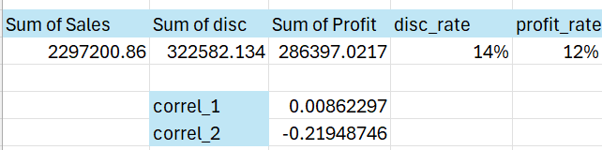
FORMULA:
=CORREL(Orders!S:S,Orders!T:T)
=CORREL(Orders!T:T,Orders!U:U)
Q6.
INSIGHTS:
Using pivot table, sum of sales, discount and profit are taken to find discount rate
Using correlation formula, found correlation between discount , quantities sold and profit
INFERENCE:
Profit and discount are negatively correlated
As discount increases, profit decreases

Slide 9
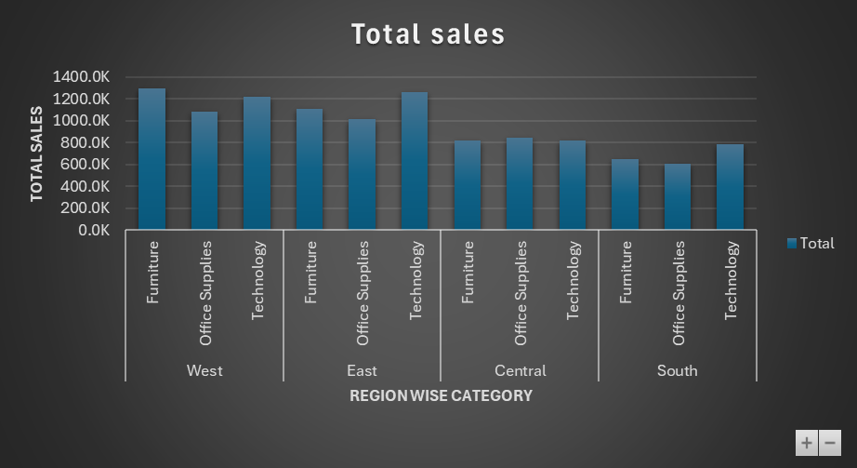
FORMULA:
Q7.
INSIGHTS:
Using pivot table, region wise category data with their sum of total sales is taken
A bar chart is created for that data
INFERENCE:
In West region, furniture is sold high
we have potential growth for furniture in west region
Technology products have high demand in east as well as in west

Slide 10
FORMULA:
Q7.
INSIGHTS:
Using pivot table, a chart is created for trends on profit for different regions
INFERENCE:
West region has high profit and central has low profit

Slide 11
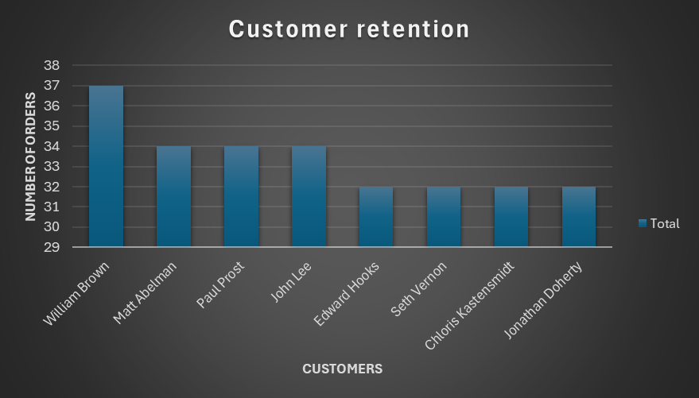
FORMULA:
Q8.
INSIGHTS:
Using pivot table, the customers and their number of orders are taken
Top 5 customers who have high retention rate are showed using a bar chart
INFERENCE:
By identifying the customer needs and promoting it, we can increase the customer retention rate
To increase the customer lifetime value, we should provide what they need and should satisfy them
Market potential growth should also be noticed

Slide 12
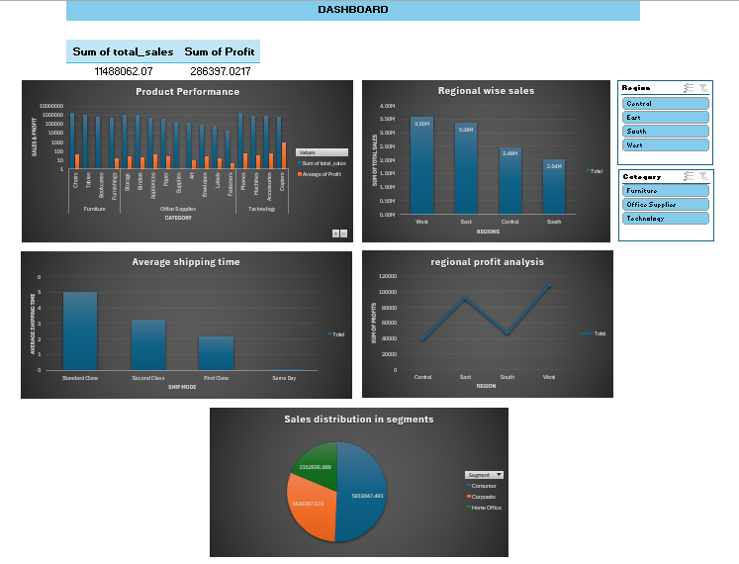
9.DASHBOARD
Using dashboard, we can see the overall product performance, regional wise sales and profits trends and sales distribution over segments. This dashboard can be used to see how sales is happening currently. It also displays total sales and profits. Used slicers, to know category wise data and regional wise data.

